Slide 1

Milestone Update
50% Project Completion Achieved
Project: Air Quality Monitoring Dashboard
Platform: Infosys Springboard
Presented by: Sharmika Gangadharan

Slide 2

Milestone 2 Overview: From Static to Interactive
Progress Snapshot
At 50% completion, the project transformed from static mockups into a fully interactive, feature-rich dashboard.
This milestone focused on three critical areas:
Frontend functionality and user interactions
Dynamic data visualization systems
Comprehensive API architecture planning

Slide 3
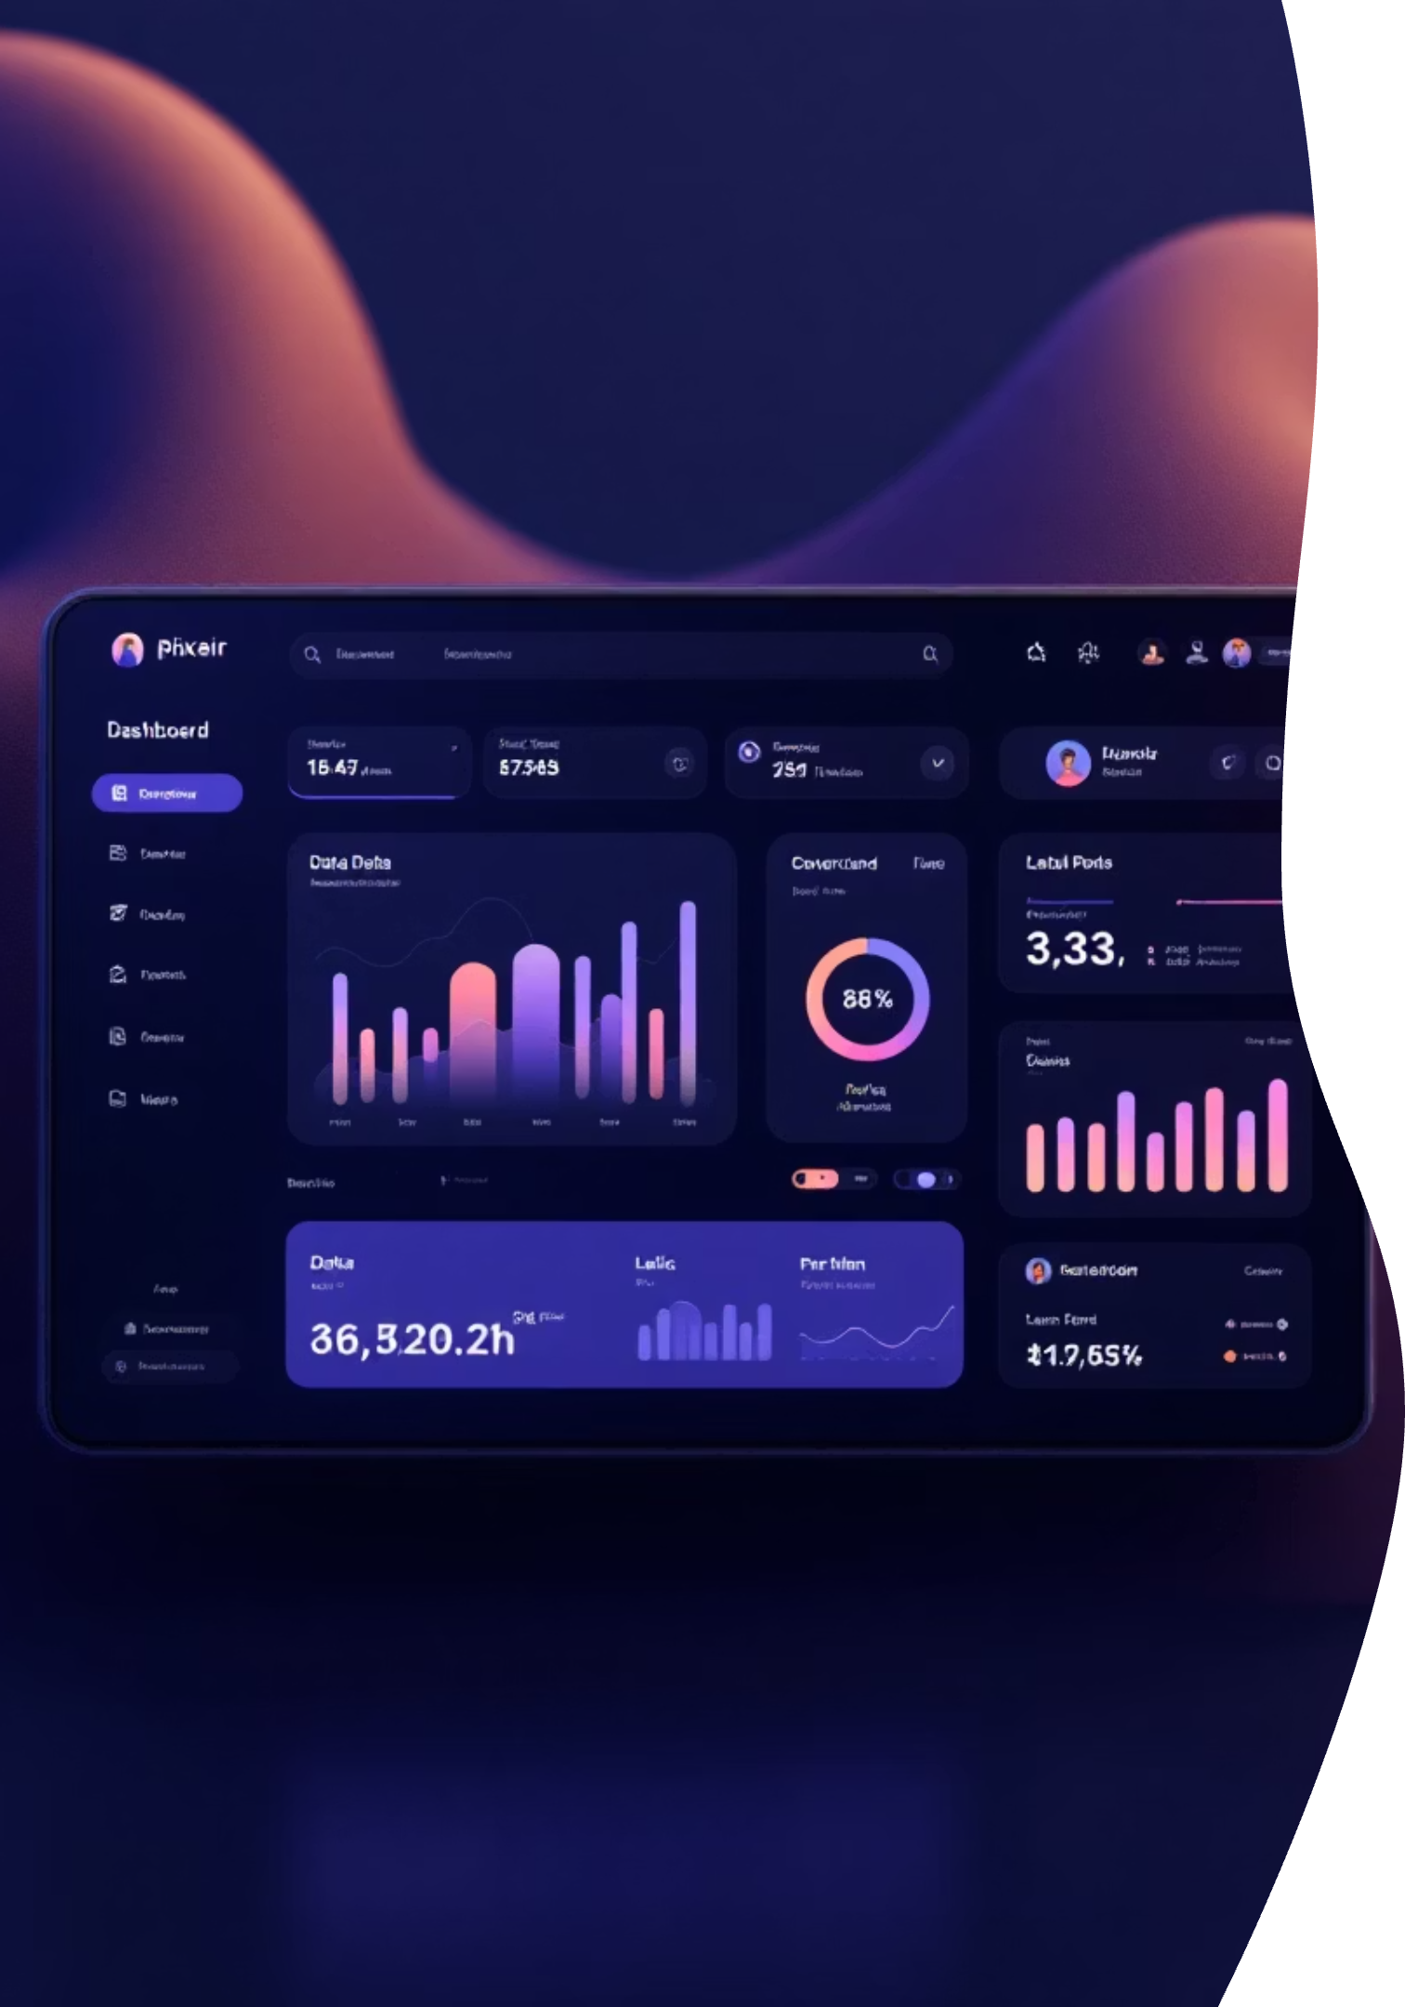
Home Dashboard Development
Visual Design
User Experience
Created a clean, intuitive layout that presents AQI data in digestible, organized sections with clear information hierarchy.
Enhanced accessibility and navigation patterns, ensuring users can quickly find critical air quality information at a glance.
Data Organization
Structured AQI data cards strategically to balance information density with visual clarity and readability.

Slide 4


Multi-Timeframe AQI Visualization
Hourly View
Daily View
Monthly View
Real-time AQI fluctuations throughout the day, enabling immediate pattern recognition.
Day-over-day comparisons revealing short-term trends and weekly patterns.
Long-term analysis showing seasonal variations and overall air quality trends.
These structured chart layouts enable comprehensive analysis and easy comparison across different time periods, helping users understand how air quality evolves.

Slide 5
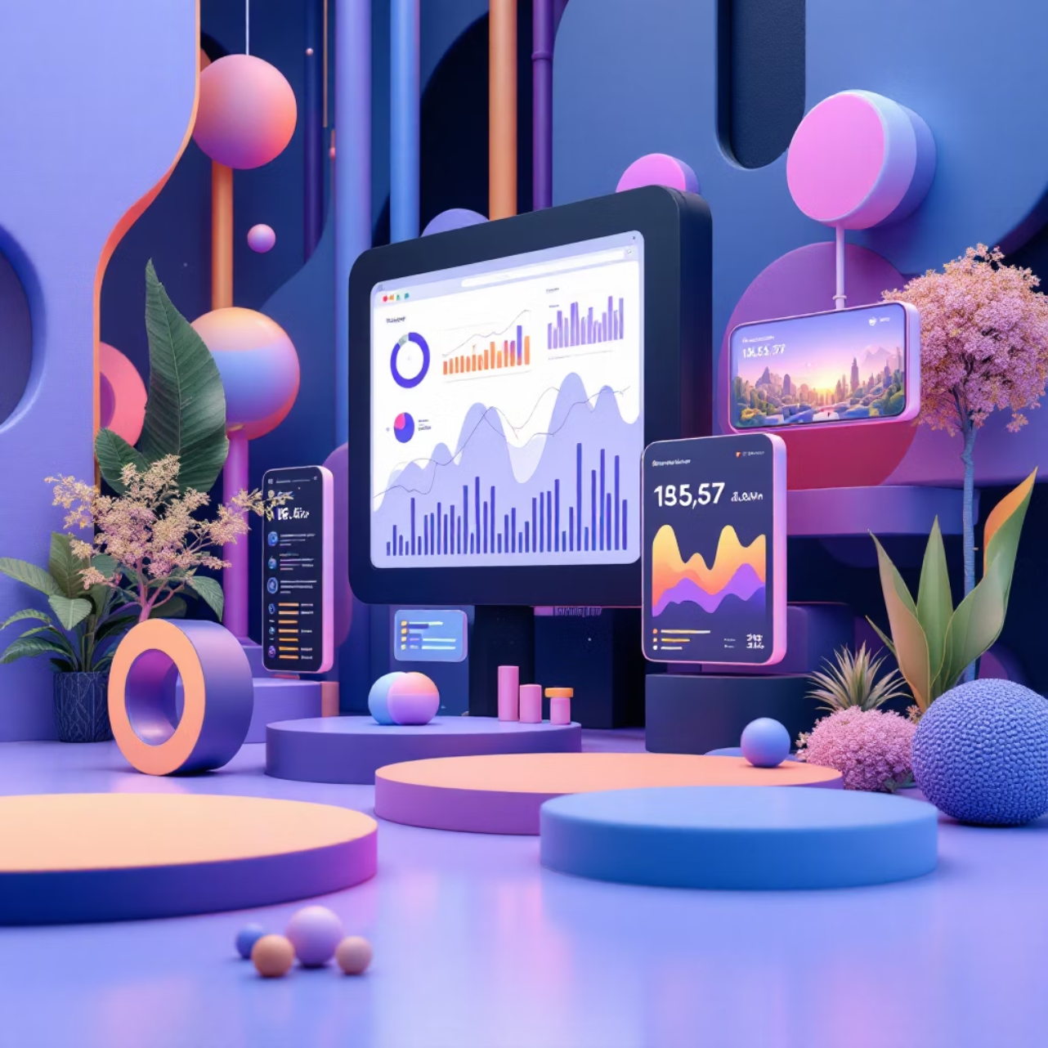
Chart.js Integration: Bringing Data to Life
Dynamic Visualization Engine
Successfully integrated Chart.js to transform raw AQI data into interactive, responsive visualizations.
Responsive charts that adapt seamlessly across desktop, tablet, and mobile devices
Interactive elements allowing users to explore data points in detail
Smooth animations and transitions enhancing user engagement
Optimized rendering performance for real-time data updates
Result: Complex environmental data becomes immediately understandable through compelling visual storytelling.

Slide 6
Advanced Feature Pages
Analytics Page
Heatmap Page
Compare Page
Deep-dive analysis tools for exploring AQI patterns, correlations, and historical trends with advanced filtering capabilities.
Geographic pollution intensity visualization using color-coded maps to identify hotspots and regional variations instantly.
Side-by-side comparison tools enabling users to analyze AQI differences across multiple locations and time periods.

Slide 7


AI Insights & Backend Architecture
AI Insights UI
Backend API Planning
Designed intelligent interface components for displaying AI-generated predictions, health recommendations, and environmental insights.
Architected comprehensive API structure for real-time data fetching, prediction services, and user interaction handling.
These foundations ensure seamless integration between frontend visualizations and backend intelligence, preparing the system for advanced AI-powered features.

Slide 8
Key Achievements & Next Steps
01
02
Fully Interactive Dashboard
Advanced Visualizations
Transformed static designs into dynamic, user-responsive interfaces
Implemented multi-timeframe charts with Chart.js integration
03
04
Feature-Rich Pages
AI & API Infrastructure
Designed analytics, heatmap, and comparison capabilities
Planned intelligent insights and backend architecture
Next Phase: Real-time data integration and AI implementation to bring the full vision to life.

